Slide 1
IBM Data Science Capstone: Car Accident Severity Report
Akshara Gopakumar

Slide 2
Problem Description
Residing in a metropolitan area my whole life, it hurts to see many people getting injured on a daily basis. I believe if we know the root cause of these injuries we can make solutions for the future. Hence, the objective of the ​project was to investigate accidents, to research on what types of traffic collisions are most likely to result in injury.

Slide 3
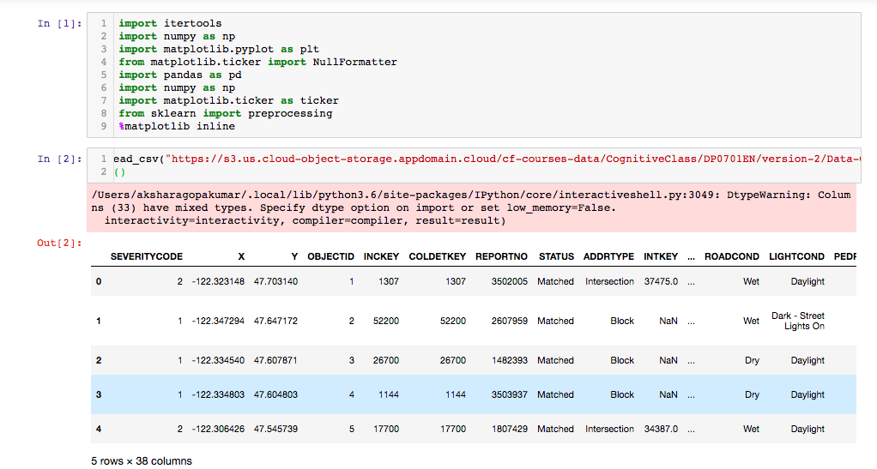
Data Understanding:
We will use SEVERITYCODE impacted by several variables, the most important ones being WEATHER, ROADCOND and LIGHTCOND

Slide 4
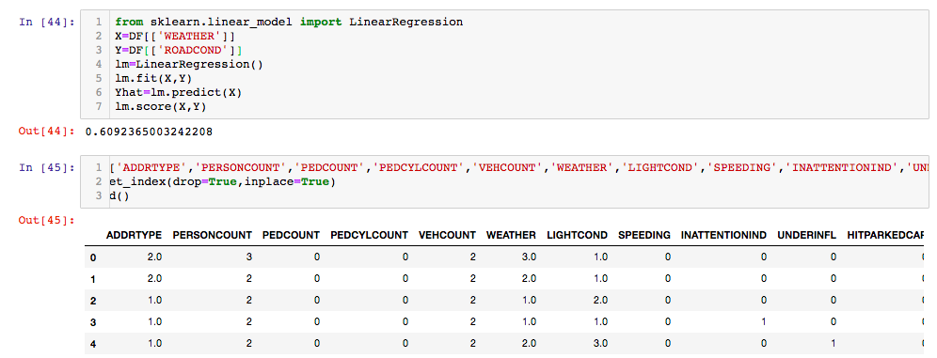
Methodology
KNN
Decision Tree
Logistic Regression

Slide 5
Data Visualization
Traffic Collisions are higher around the block than in intersections and alleys

Slide 6
Parked Cars tend to have more collisions rather than the other types while Head on collisions are much more rare than we think.

Slide 7
Result and Evaluation
Then we checked the accuracy and found out that the Decision tree is the most accurate model.
Most crashes happened in clear, dry, and bright conditions. Most days are clear, dry, and bright, so it’s no surprise that most car crashes occur under these conditions. I also found out that crashes with a distracted driver or an impaired driver are statistically more likely to result in injury, which is also not a surprise. The results of the data indicate to city officials that they should ask drivers to be more alert in ideal conditions.

